Slide 1

Unmanned Aerial Vehicle (UAV)
SHAMHAN MUAADH
1716129

Slide 2
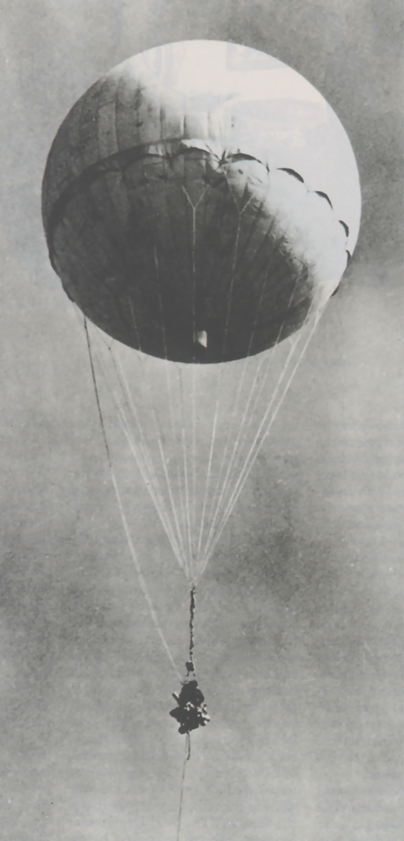
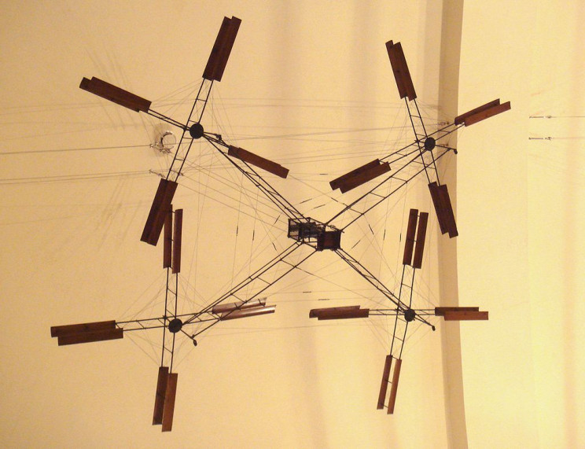
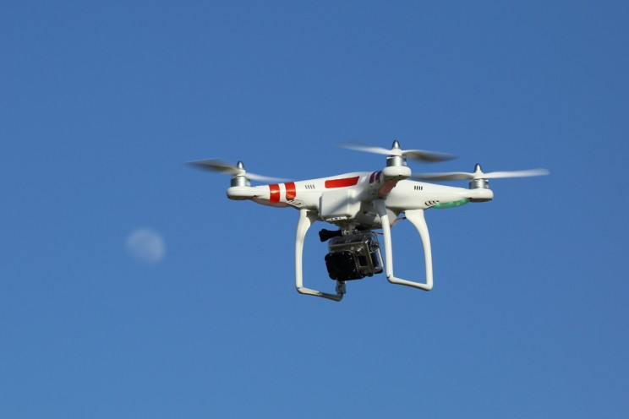
History of UAVs
The earliest recorded use of an unmanned aerial vehicle for warfighting occurred in July 1849 during the Austrian incendiary balloon attack on Venice, with a balloon carrier (the precursor to the aircraft carrier) in the first offensive use of air power in naval aviation.
One common feature of many modern commercial drones is the quadcopter configuration. Early development of this technology appeared in 1907, when brothers Jacques and Louis Bréguet, with help of French physiologist Professor Charles Richet, developed an early example with their gyroplane, a forerunner of the helicopter.
The last 10 years or so have seen a huge explosion in drone innovation and commercial interest. While prior to this, drones were primarily used for military purposes or hobbyists, beginning in the early-2010s, a host of new uses were proposed for drones, including their use as delivery vehicles and commercial photography

Slide 3
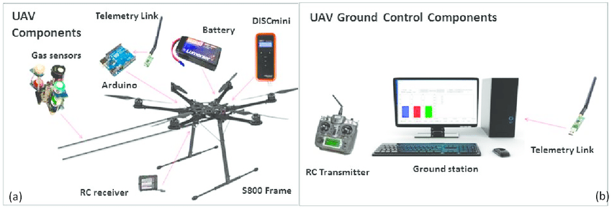
Basic System Architecture
Hexacopter S800 EVO, a UAV Based System for Air Pollution Measurements

Slide 4
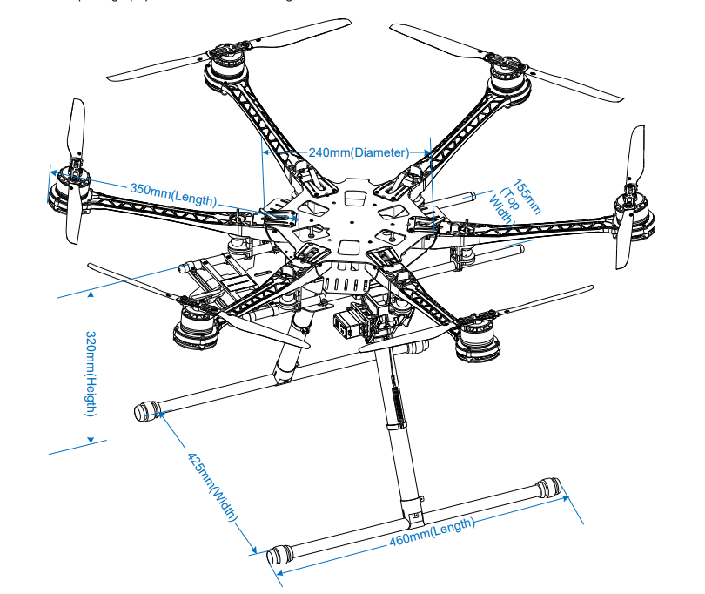
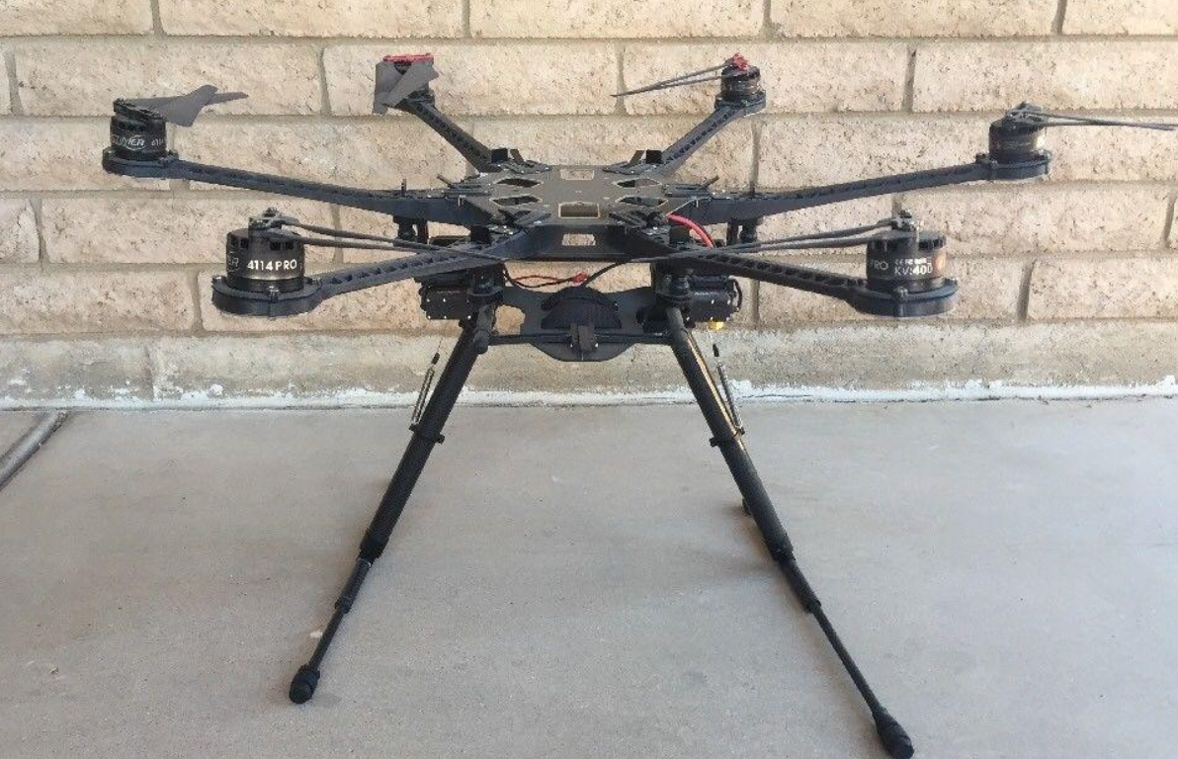
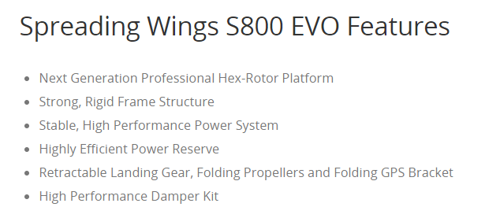
Robot Design Vs. Tasks
The frame measures 800 mm in width and 320 mm in height and is made of composite materials. The built-in damping system allows the multi-rotor to be assembled without additional frames and dampers. The UAV weighs 3.7 kg with a maximum take-off weight of 8 kg. The S800 is designed to operate under the 20 kg all up weight (AUW) class of UAS (Unmanned Air System) as defined by the Civil Aviation Safety Australia (CASA) to reduce operation costs and avoid being subject to the tighter CASA regulations for larger UAVs.

Slide 5
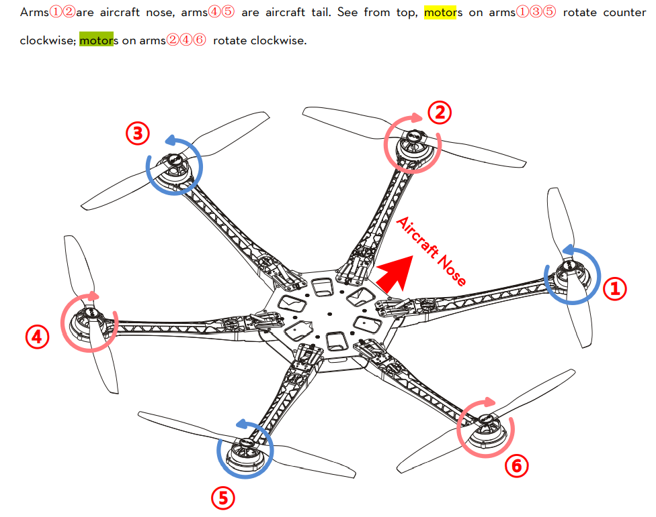
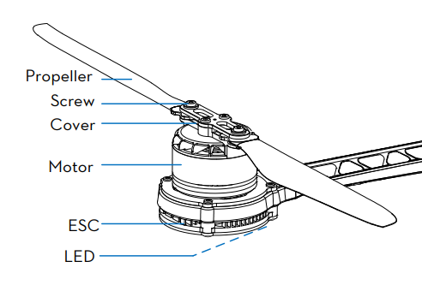
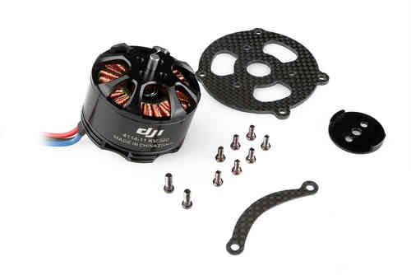
Actuators and Locomotions

Slide 6
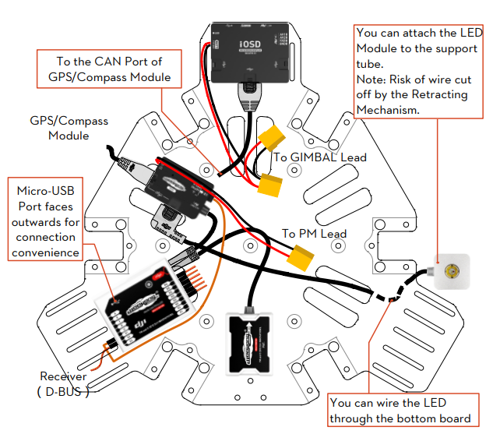
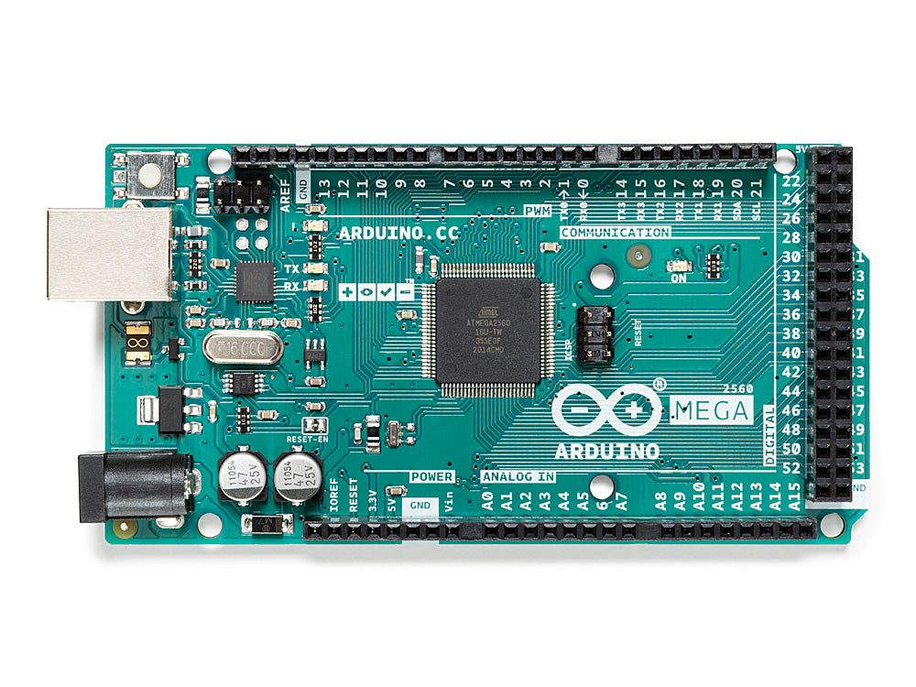
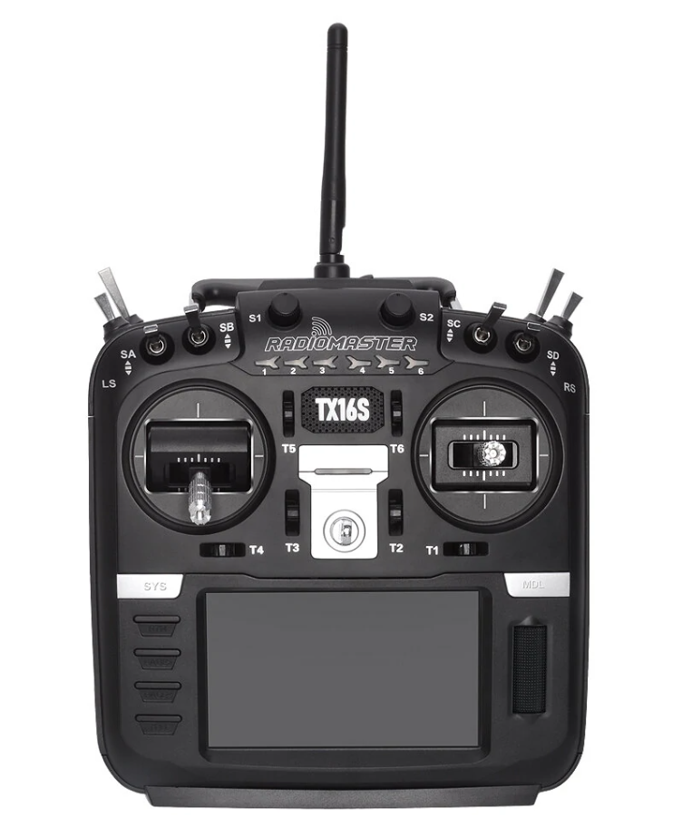
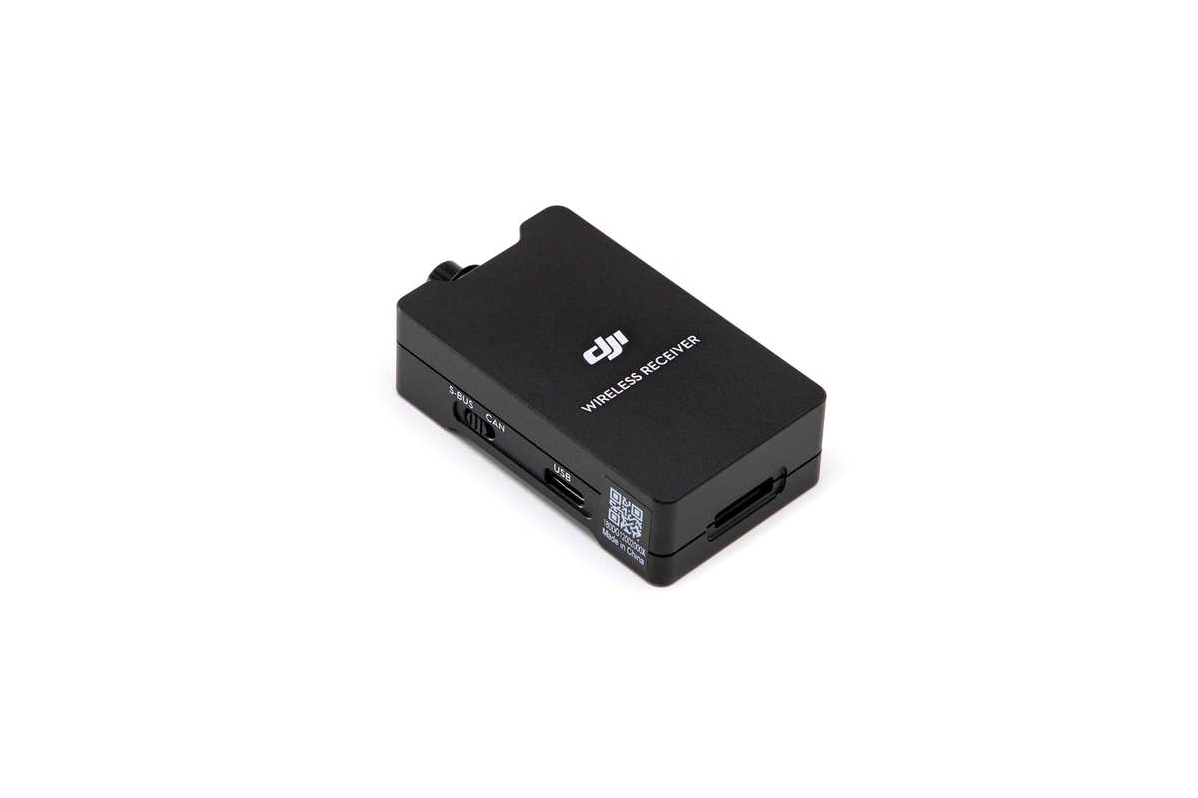
Navigation System & Controller
RC transmitter
Arduino mega as controller
The Arduino is easier to use for its connectivity and programming, better speed for receiving and transmitting data, and lower power consumption. The Arduino can power all four gas sensors simultaneously
RC receiver
GPS for localization

Slide 7
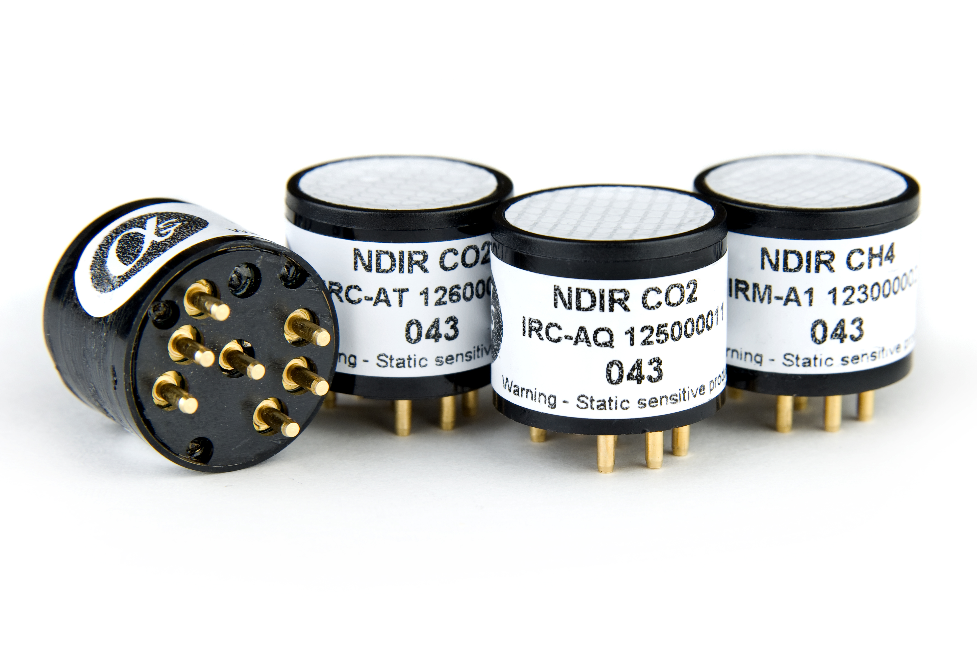
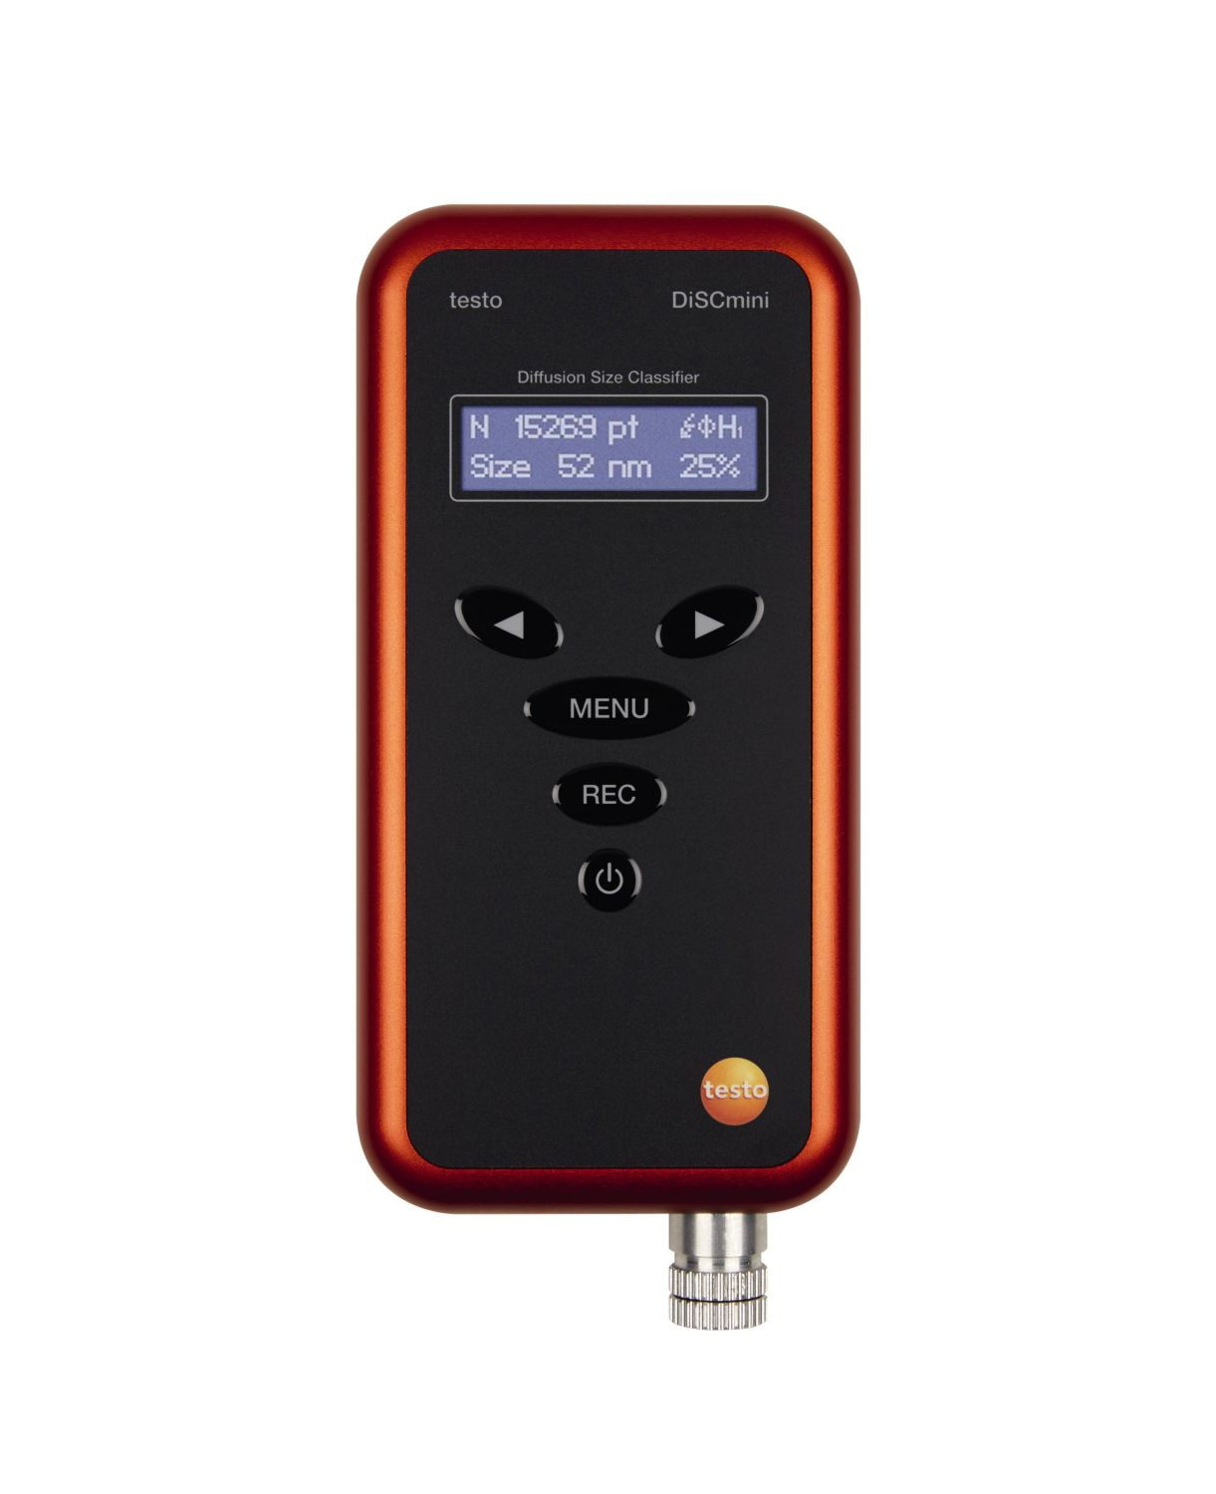
Data Collections
electrochemical cells that operate in the ampere-metric mode and generate a current that is linearly proportional to the fractional volume of the measured gas.
The DISCmini is a portable instrument of relatively small dimensions, low weight and long battery duration used to measure the number of particles in a certain area.

Slide 8
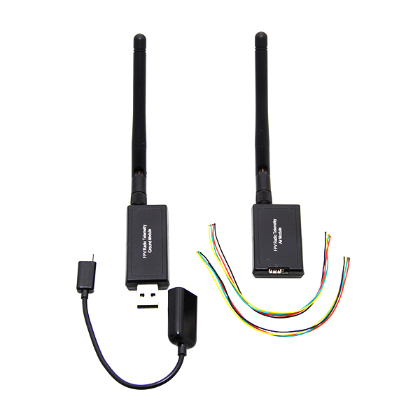
Data Transmission
The UAV system architecture uses a radio modem to transmit real-time data including information on the three-dimensional location of the UAV and payload parameters to the ground station.
Telemetry links

Slide 9
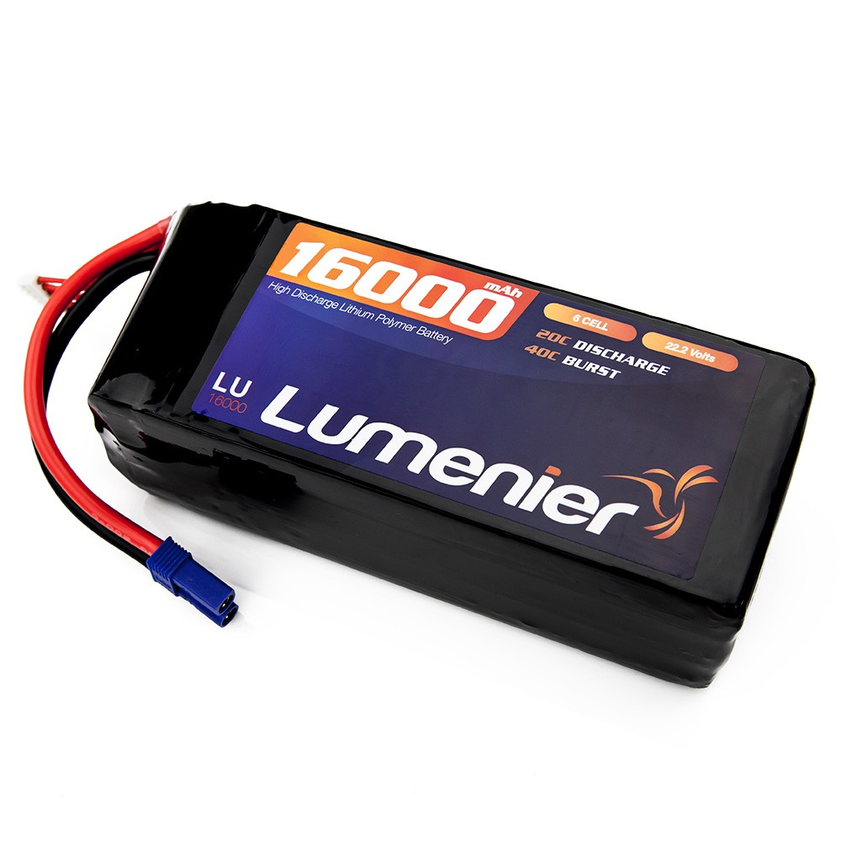
Power System Management
The UAV uses a 16,000 mAh LiPo 6 cell battery, which provides a hover time of approximately 20 min with no additional payload. However, the flight time with the gas sensors payload is about 12–13 min.

Slide 10
List of UAV Companies
Locally:
AERODYNE
POLADRONE
DEFTECH
Internationally:
DJI (China)
Parrot (France)
Skydio (US)
Kawasaki Aerospace (Japan)

Slide 11
References
Villa, T., Salimi, F., Morton, K., Morawska, L., &amp; Gonzalez, F. (2016). Development and validation of a UAV based system for Air Pollution Measurements. Sensors, 16(12), 2202. https://doi.org/10.3390/s16122202
Dji website: https://www.dji.com/spreading-wings-s800-evo

